Slide 1
Introduction to Computer Graphics 780.214
Diego Marillan Cuevas
12341866
20/01/2025

Slide 2
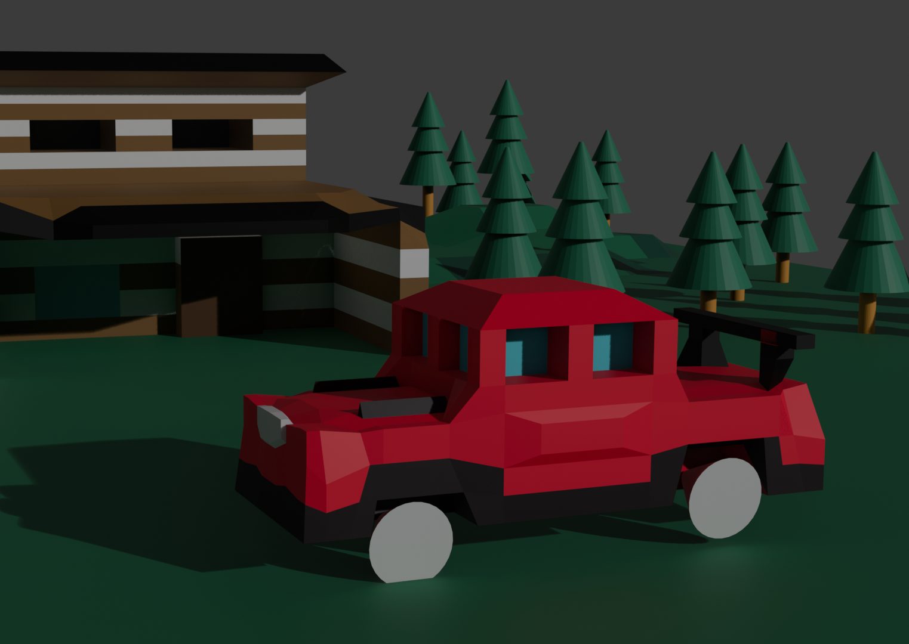
Final Project, Blender
Models
Render

Slide 3
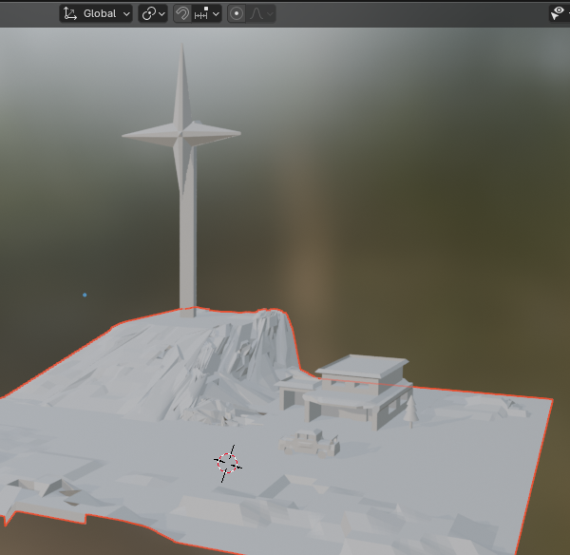
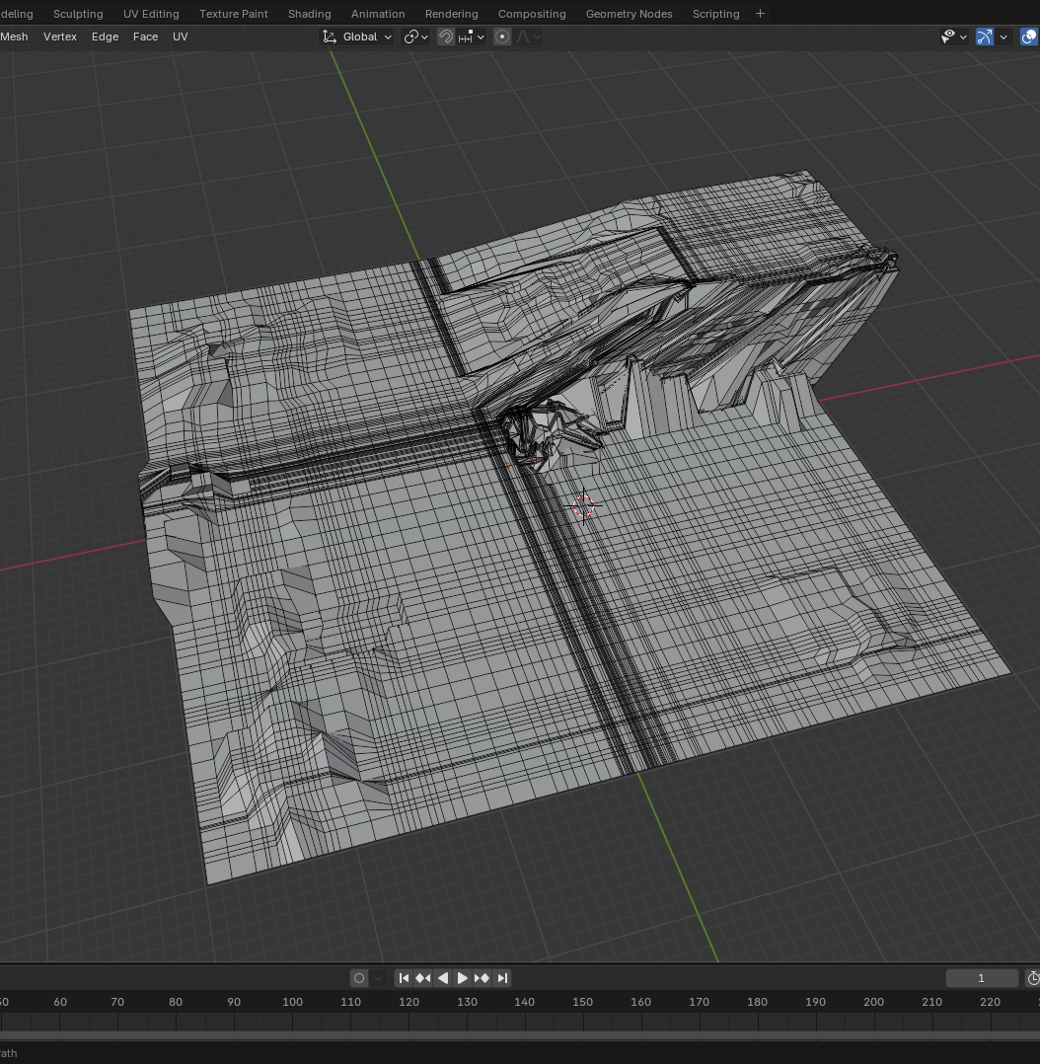
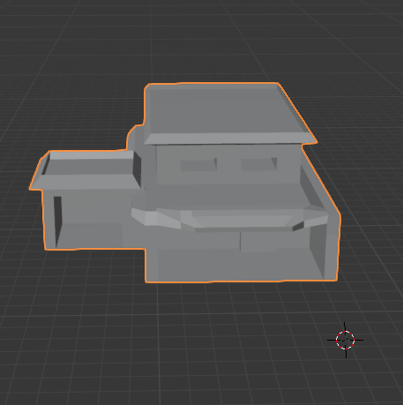

Process
Separated models and layers
Paint the models
Merge everything

Slide 4
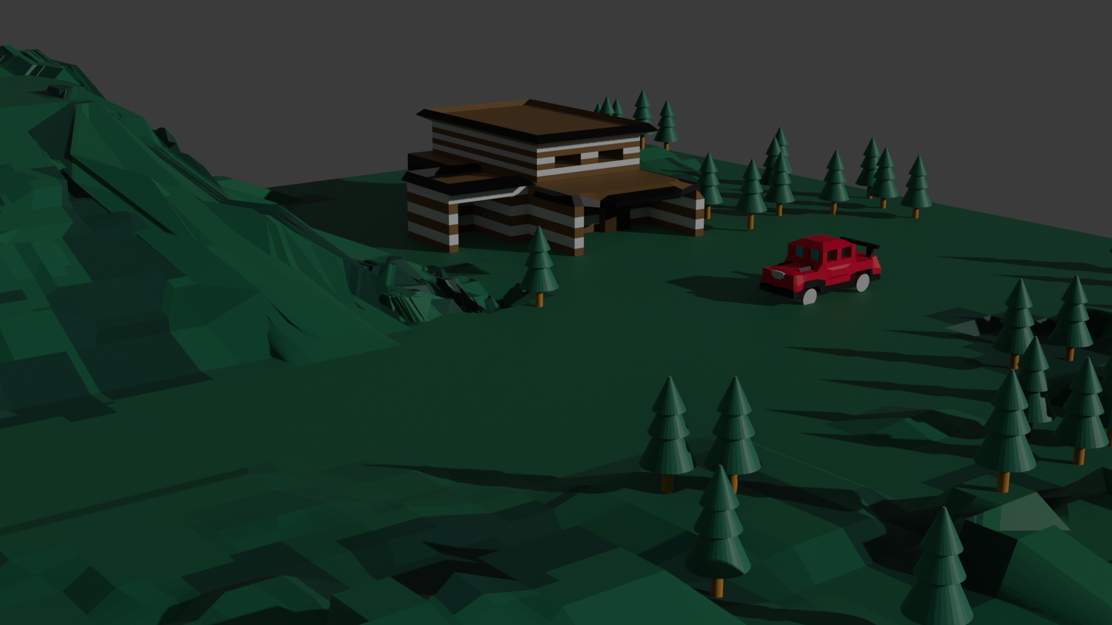
What I did

Slide 5
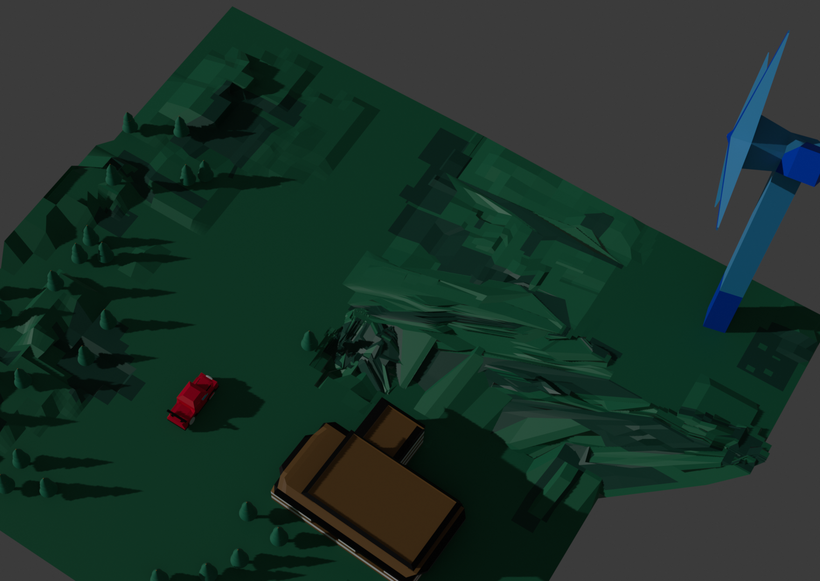
How I did it
Patience
YouTube Tutorials
Messing up

Slide 6
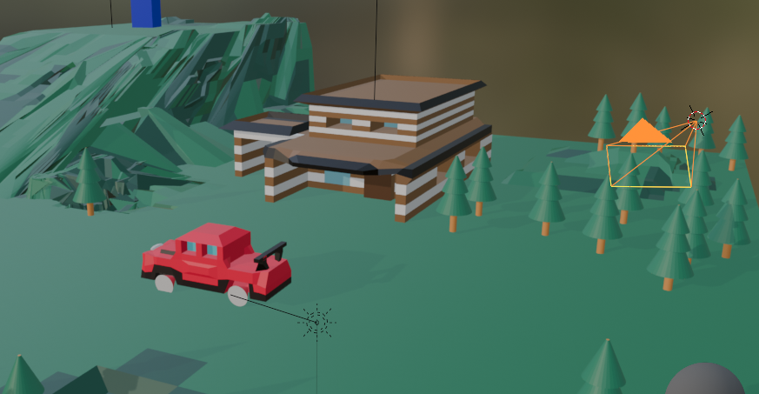
Final Result

Slide 7
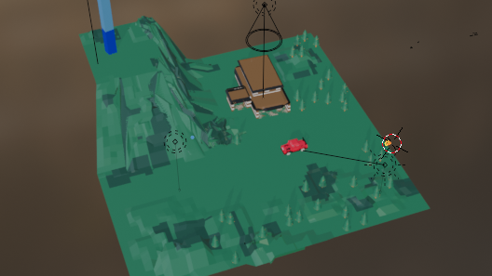
Thank you

